Slide 1

Reinforcement learning: scheduling and resource allocation (PS-006)
Data Explorers
Khalid Albagami
Bayan AlOquibi
Abdullah Alajlan
Raghad Alturki

Slide 2
Introduction
The reinforcement learning is useful for beamforming problem in MIMO system.
The beam selection problem is modeled as a game (simulated using CAVIAR).
CAVIAR simulation integrates three subsystems:
Communication system
AI and ML models
virtual reality (VR) or augmented reality (AR) components.

Slide 3
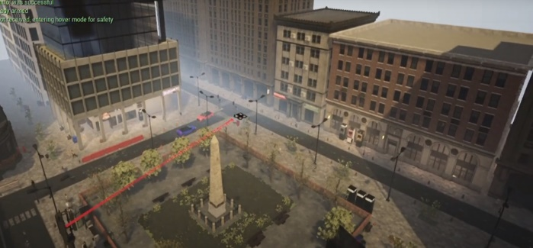
Introduction
The problem is based on simulating a communication system immersed in a virtual world created with AirSim and Unreal Engine.
The goal is to schedule and allocate resources to Unmanned Aerial Vehicles (UAVs), cars and pedestrians, composing a scenario with aerial and terrestrial users equipment (UEs).
The base station
RL Agent
States
Rewards
Actions
Environment
(Channel, buffer and GPS location)

Slide 4
Environment Dataset
Precalculated environment dataset
Three categories of UEs: UAVs (unmanned aerial vehicle), cars and pedestrians.
Data includes: location, orientation, velocity and acceleration.
Live environment data
It provides information about the packets: transmitted, buffered and dropped.
It also contains information about the channel magnitude and bitrate for each transmission interval 10 ms.

Slide 5
Model output
RL Agent
Model output
(beam a, UE1)
(beam b, UE2)
(beam c, UE3)
Time
With min dropped packets and max transmission packets
At each transmission interval → 10ms
37 UEs
UE1
UE2
UE3

Slide 6












Simulation Environment
Episode
0
Current State
Actions
Pre-calculated
Selected UE position
- - -
UE1
X
Y
Z
Rewards
Throughput
+1
-
UE2
Live
Selected UE
-
- 2
Sent packets
Reward =
-
UE3

Slide 7
Simulation Environment
Episode
1
Current State
Actions
Pre-calculated
Selected UE position
UE2
X
Y
Z
-9
-14
8
Rewards
UE1
Throughput
-1.5
300 Mbps
Live
Selected UE
UE2
- 2
Sent packets
Reward =
3400
UE3

Slide 8
Simulation Environment
Episode
2
Current State
Actions
Pre-calculated
Selected UE position
UE2
X
Y
Z
-7
10
4
Rewards
UE1
Throughput
+0.7
2.5 Mbps
Live
Selected UE
UE1
- 2
Sent packets
Reward =
UE3
30

Slide 9




Agent experience
Current state | Actions | Future state | Rewards
- | Beam3|UE2 | -9,-14,-8|300|UE2|.. | +1
-9,-14,-8|300|UE2|.. | Beam5|UE1 | -7,10,4|2.5|UE1|.. | -1.5
-7,10,4|2.5|UE1|.. | Beam5|UE3 | … | …
… | … | … | …
… | … | … | …

Slide 10
Training
Hyper parameters
Agent
Reward function
Observation space
Notes:
We have started with the baseline model while trying to manipulate the Hyper parameters to enhance the learning process.
After fixing the hyper parameters we thought about building a new agent, that is DQN to compare each change we do latter with the results of A2C and see which gives better results
After that, we tried different reward to see the effect of changing the reward on the learning process, once the model is trained we test it using the same baseline reward to have a common way of judging the performance.
In addition to all above, we also considered changing the observation space as we believed it has the most potential of giving a cumulative reward. We started by lowering the number of states by eliminating one state at a time and see how it affects the overall result, we also tried adding new states to enhance the learning process.

Slide 11
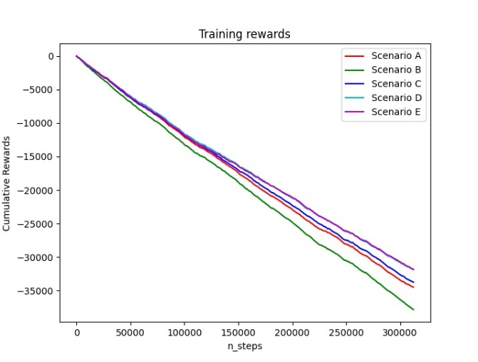
Results
Scenario | Observation Space | Number of states
A | Channel Magnitude, target UE, Transmitted Packet | 3
B | Channel Magnitude, target UE (x,y,z) position | 4
C | Transmitted, buffered, dropped packets. | 3
D | (x,y,z) position for target UE and other UEs, target UE buffer and other UEs buffer | 12
E | Target UE, target UE buffer, other UEs buffer. | 4
Baseline | Target UE (x,y,z) position, transmitted, buffered, dropped packets, and bits rate | 7

Slide 12
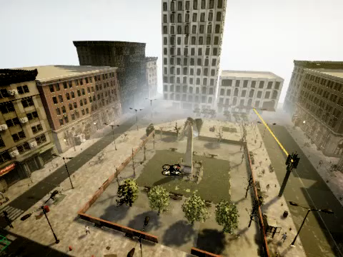
Demo

